Slide 1
PREDICTING HEART STROKE WITH CDC's BRFSS2015 DATA
Business Intelligence
Ayushi Dubey
Anjali Gaurav
Anirudh Kotamarthy
Dharma Tej Vasikarla
Rahul Kapoor

Slide 2
Agenda
SYNOPSIS | X
METHODLOGY | X
MODELS USED | X
DATA CLEANING | X
LOGISTIC REGRESSION | X
RESULTS | X
APPENDIX | X

Slide 3
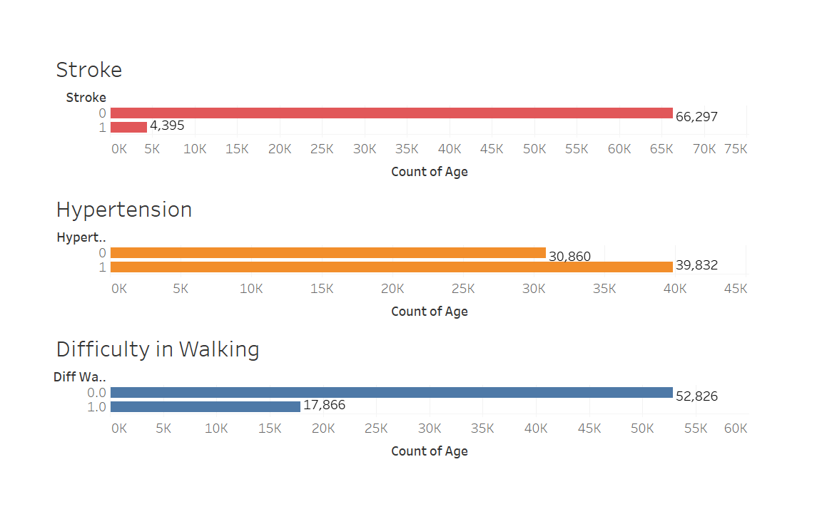
SYNOPSIS
Objective:
To predict the probability of heart stroke, diabetes and hypertension.
Dataset:
PREDICTING HEART STROKE WITH CDC's BRFSS2015 DATA

Slide 4
Data Evaluation and Cleaning
Data Distribution
Skewed towards Class 0 in Heart stroke Variable
PREDICTING HEART STROKE WITH CDC's BRFSS2015 DATA
Notes:
Data is skewed. Data has more people who already had a stroke. 80% of the data has people with stroke. There is a class imbalance in the dataset and stroke is an important dependent variable which we want to predict. With less data the model built on this will have poor predictive performance.​
​

Slide 5
Heart attack Distribution
POST BALANCING DISTRIBUTION
PREDICTING HEART STROKE WITH CDC's BRFSS2015 DATA

Slide 6
METHODOLOGY
DATA CLEANING
LOGISTIC REGRESSION
VARIABLE IMPORTANCE
RESULTS
PREDICTING HEART STROKE WITH CDC's BRFSS2015 DATA

Slide 7
MODELS USED
We implemented 4 models:
Logistic regression
K Nearest Neighbor
Gaussian Naïve-Bayes
Adaptive Boosting
Out of all these models, we decided to employ Logistic Regression based on the accuracy
PREDICTING HEART STROKE WITH CDC's BRFSS2015 DATA

Slide 8
RESULTS

Slide 9
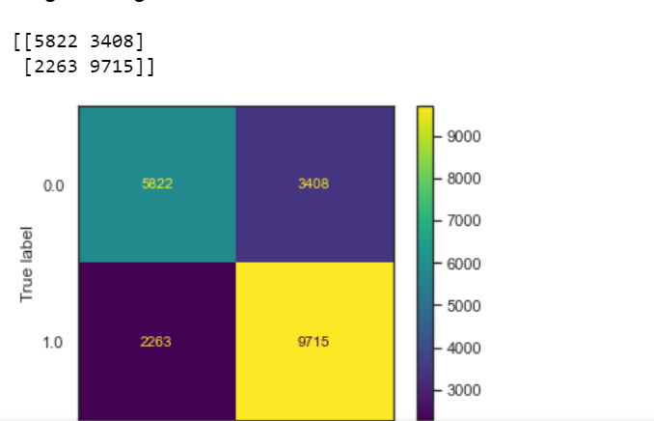
HYPERTENSION
Accuracy of the Classifier: 73.3%
True Negative: 3408
False Positive: 2263
PREDICTING HEART STROKE WITH CDC's BRFSS2015 DATA

Slide 10
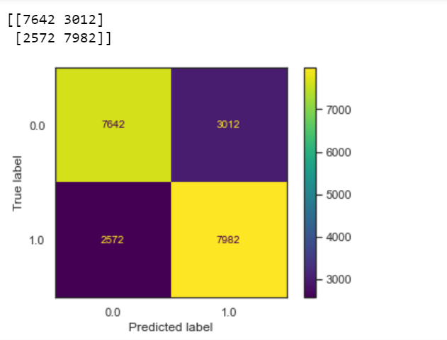
DIABETES
Accuracy of the Classifier: %
True Negative:
False Positive:
PREDICTING HEART STROKE WITH CDC's BRFSS2015 DATA

Slide 11
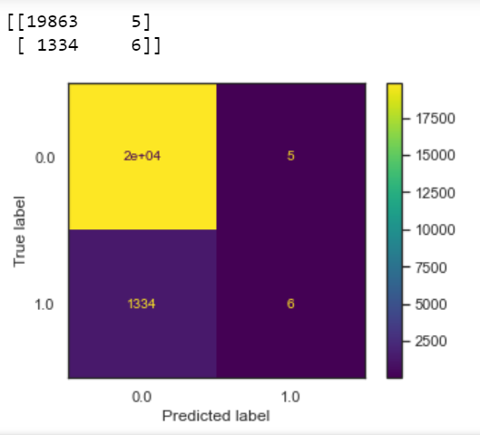
HEART STROKE
Accuracy of the Classifier: 93.7%
True Negative: 5
False Positive: 1334
PREDICTING HEART STROKE WITH CDC's BRFSS2015 DATA

Slide 12
VARIABLE IMPORTANCE
ADD SOME BAR CHART HERE TO SHOW VARIABLE IMPORTANCE/WEIGHTAGE
PREDICTING HEART STROKE WITH CDC's BRFSS2015 DATA

Slide 13
METHODOLOGY-2
PREDICTING
Predicting the chances of a heart-stroke
CLUSTERING
Clustering the data using K-Means Clustering
TRAINING
Training a random forest model to determine the Gini Index
BALANCING
Balancing the Data using SMOTE Sampling.
PREDICTING HEART STROKE WITH CDC's BRFSS2015 DATA

Slide 14
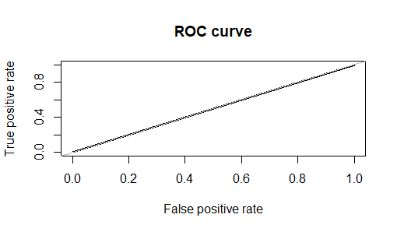
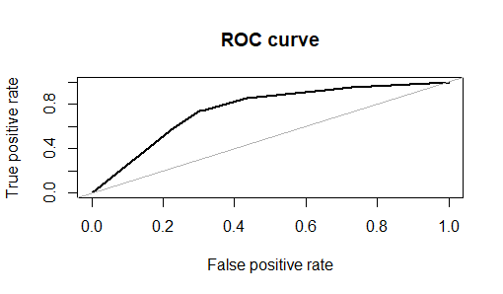
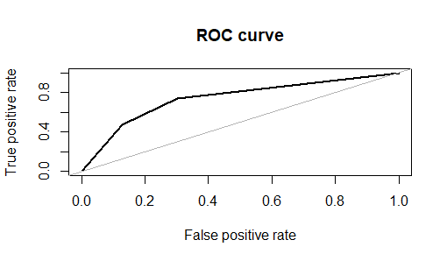
BALANCING THE DATA
Over Sampling
Under Sampling
Both – Under + Over Sampling
SMOTE Sampling
PREDICTING HEART STROKE WITH CDC's BRFSS2015 DATA
Notes:
To improve the predictive performance, we balanced the data.​
If we under sample we might loose some important information and if we oversample it will just increase the minority values and it could still be biased. If we use balanced it will just balance out the data.​
​
We used SMOTE (Synthetic Minority Oversampling Technique) sampling to sample the data. Synthetic sampling will create the data which will be a replica of the existing data instead of expanding only the minority class.​
​
SMOTE works by selecting examples that are close in the feature space, drawing a line between the examples in the feature space and drawing a new sample at a point along that line.​
​
Specifically, a random example from the minority class is first chosen. Then k of the nearest neighbors for that example are found (typically k=5). A randomly selected neighbor is chosen and a synthetic example is created at a randomly selected point between the two examples in feature space.​
​
​

Slide 15
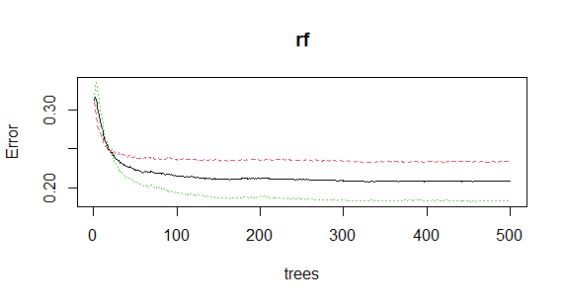
TRAINING AND TESTING
PREDICTING HEART STROKE WITH CDC's BRFSS2015 DATA
Notes:
We ran random forest model on the synthetic sampled data for 500 iterations. Error rate is very high up to 100 trees. And the error rate was constant at approx. 125 trees. The graph plateaued after that. We found that number of iterations can be restricted to 125 trees to run the model with different variables and optimize resource utilization. We ran the decision tree model and got the output. From this output the accuracy of output is 80%. ​
We ran this for Heart stroke and the data says we can predict heart attack with 80% accuracy.​
About random forest
https://towardsdatascience.com/understanding-random-forest-58381e0602d2

Slide 16
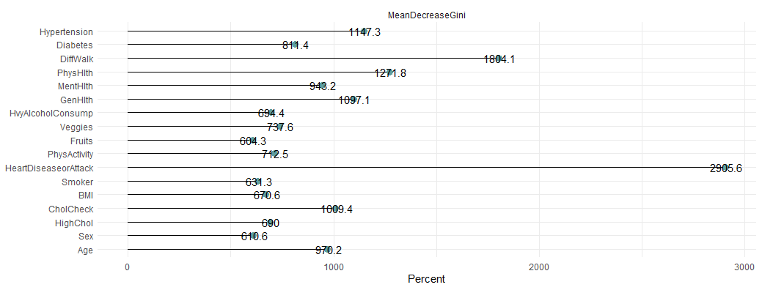
GINI INDEX
PREDICTING HEART STROKE WITH CDC's BRFSS2015 DATA
Notes:
Gini Index show which of the variable is so important is showed. This variable can be used as the root. We ran Random forest for 500 iterations and it suggested Heart disease attack as the most important variable. We can also see the importance of different variables in the entire dataset.​

Slide 17
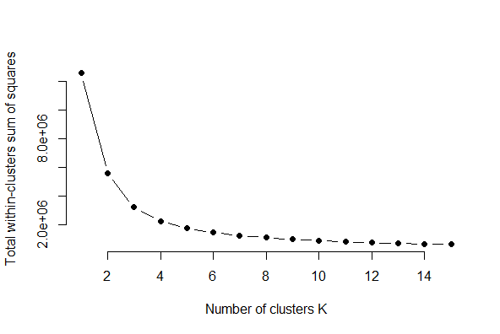
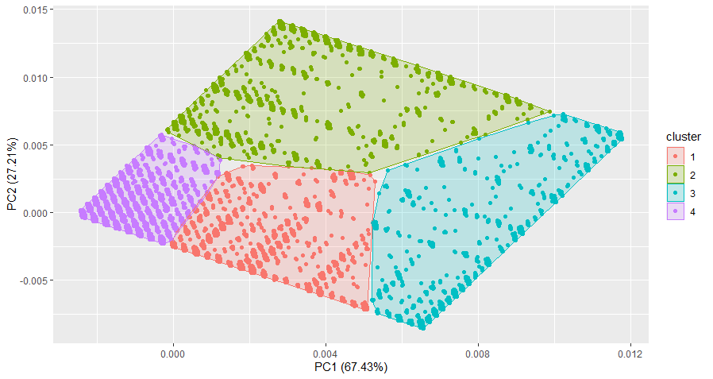
CLUSTERING THE DATA
Determination of no. of clusters
Visualization of the Clusters
PREDICTING HEART STROKE WITH CDC's BRFSS2015 DATA
Notes:
From random forest we found which of the variables are important and formed a cluster. We observed a clear separation without any overlap at 4 clusters.​

Slide 18
RESULTS

Slide 19
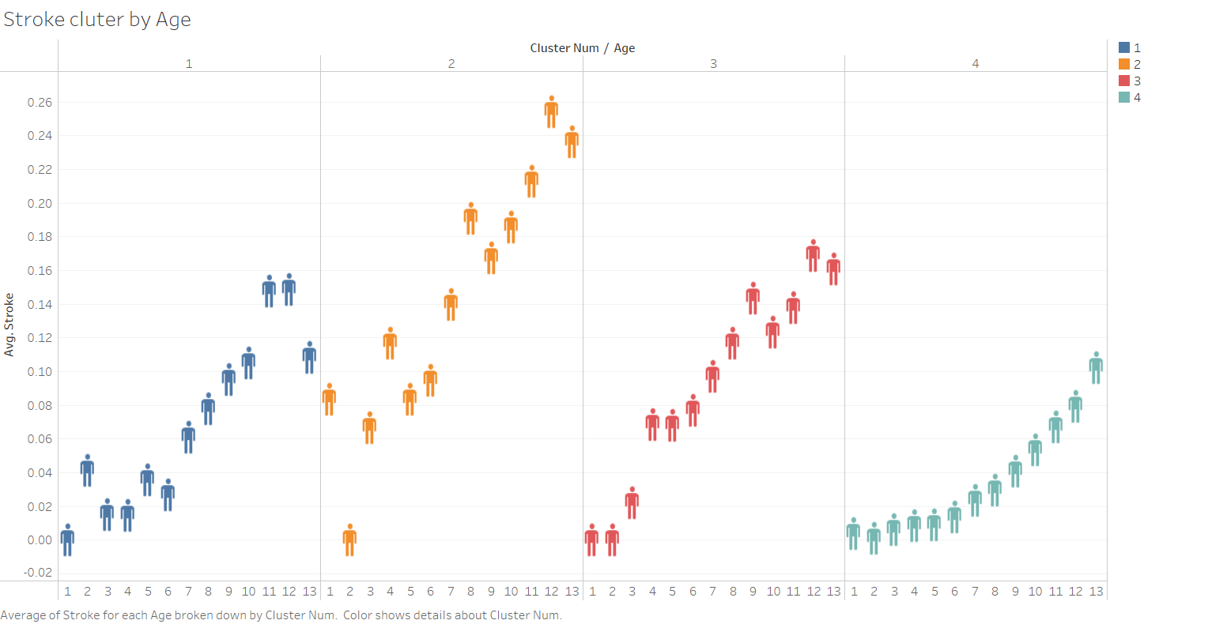
Probability of stroke in each cluster​
PREDICTING HEART STROKE WITH CDC's BRFSS2015 DATA
Notes:
This visualization shows the probability of stroke in each cluster. Cluster 2 has more probability of stroke. Now let’s see the cluster with each variable.​

Slide 20
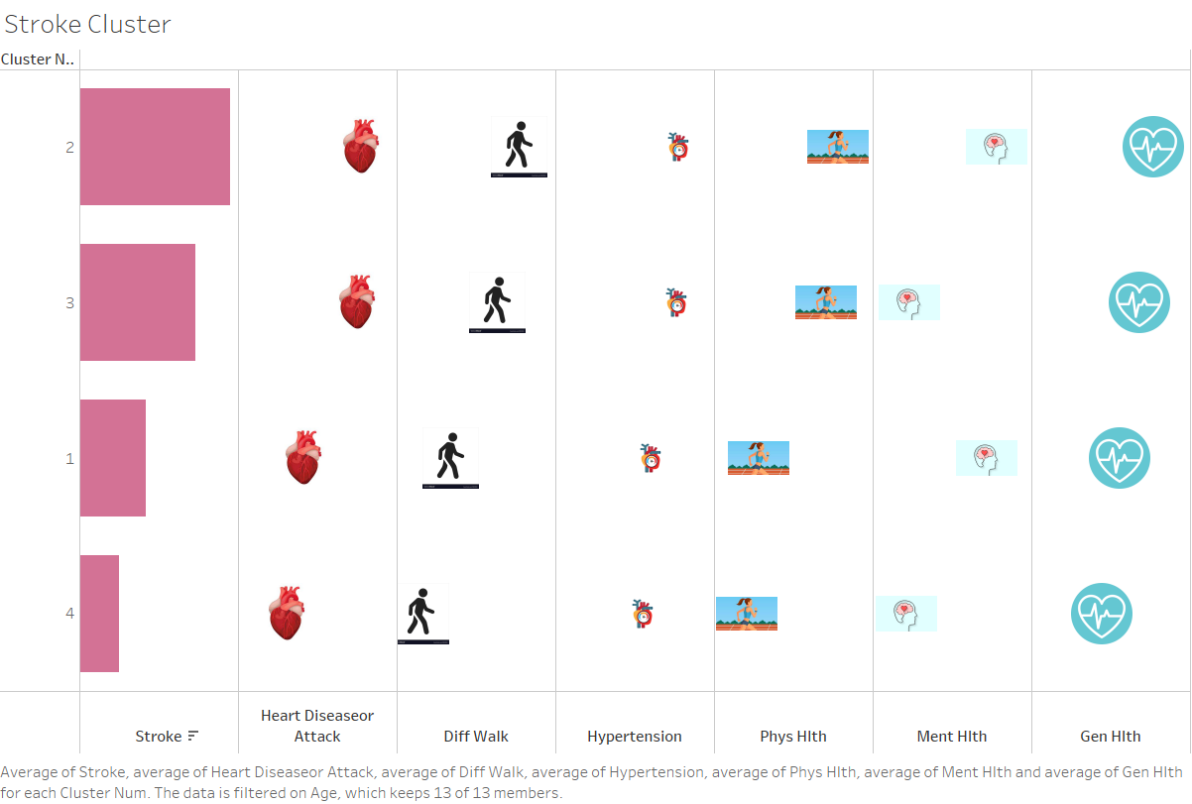
Probability of stroke in each cluster​
PREDICTING HEART STROKE WITH CDC's BRFSS2015 DATA
Notes:
This visualization shows that cluster 2 with the following attributes has more probability of stroke.​
The attributes for cluster 2 are,​
Past history of heart attack​
Higher difficulty in walking​
Have hypertension​
Lower overall physical health​
Lower mental health​
Lower general health​
​
People with above attributes have higher chance of heart attack.​
​

Slide 21
Thank You!
Property Assessment Case – Big Data Analytics in Finance

